Slide 1
How to Check your ACC Class Schedule
College Prep
Mr. Gordon
jgordon@bisdtx.org

Slide 2
Upcoming Events
hi

Slide 3
ACC Classes
Follow the instructions on the following slides to verify that you are registered for the correct classes.
hi

Slide 4
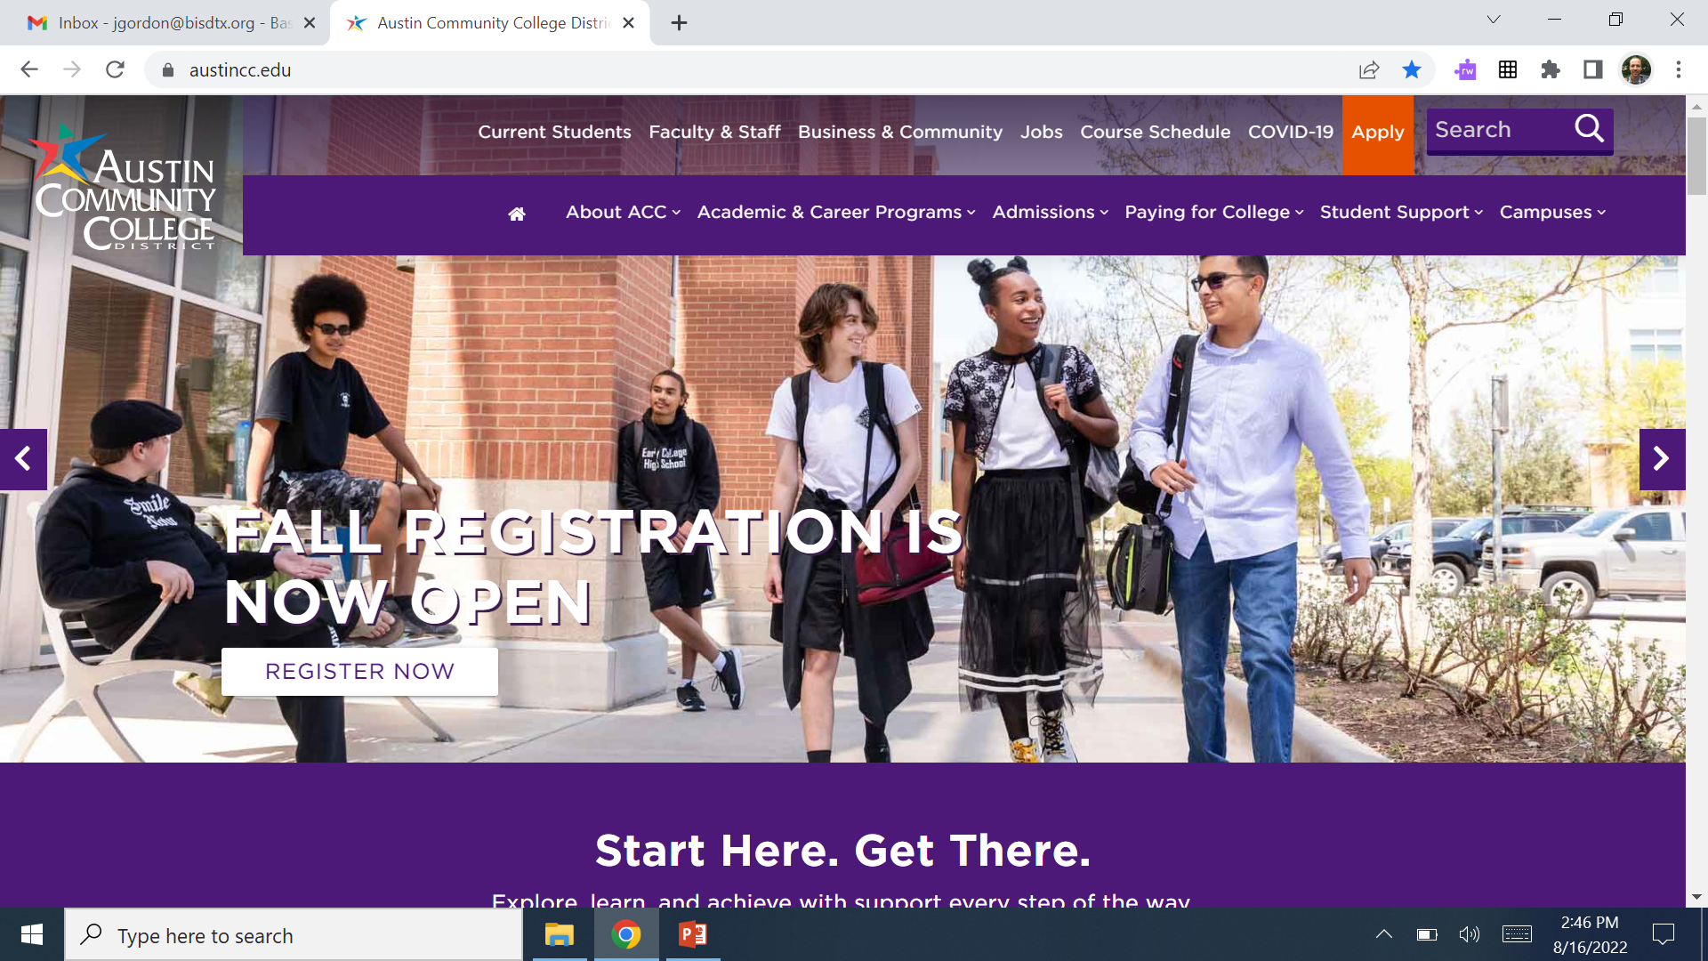
ACC Classes
Step 1: Go to austincc.edu and click “Current Students” at the top
hi

Slide 5
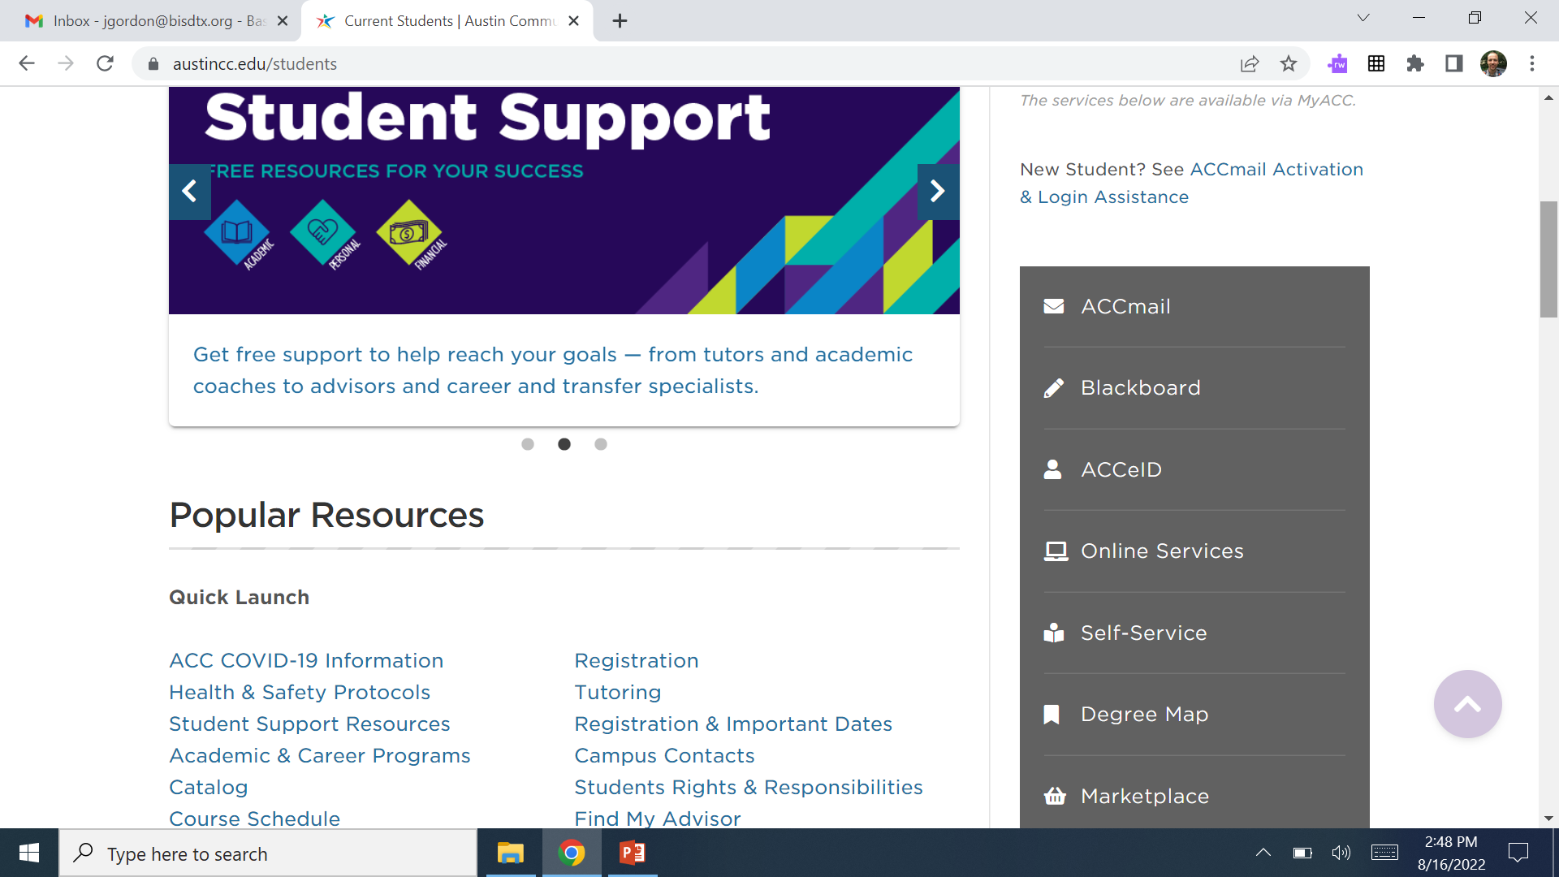
ACC Classes
Step 2: Scroll down and click “Self-Service” in the middle right
hi

Slide 6
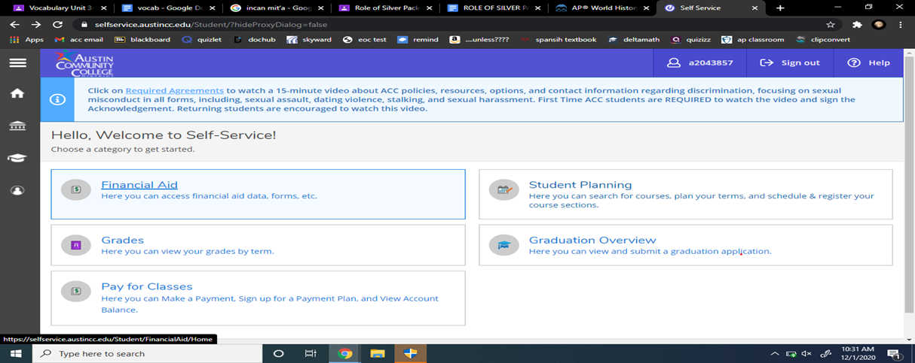
ACC Classes
Step 3: Login to MyACC and click on “Student Planning”
hi

Slide 7
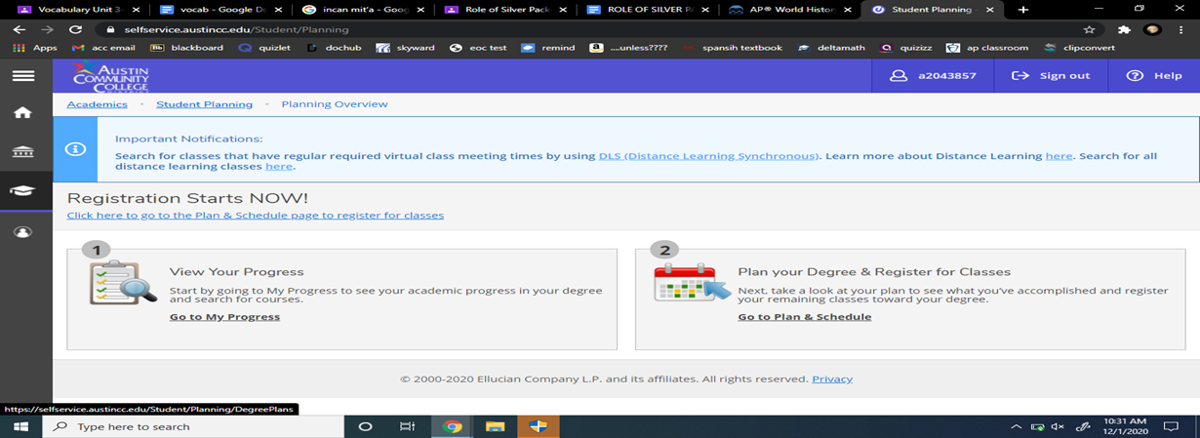
ACC Classes
Step 4: Click on “Go to Plan & Schedule” under Plan your Degree & Register for Classes
hi

Slide 8
ACC Classes
Step 5: Scroll down and you will see the schedule.
Step 6: Verify that you are registered for the correct classes,
for example SPAN- 1411- Spanish 1
and DRAM-1310 Theatre Appreciation.
(See Following Slide)
hi

Slide 9
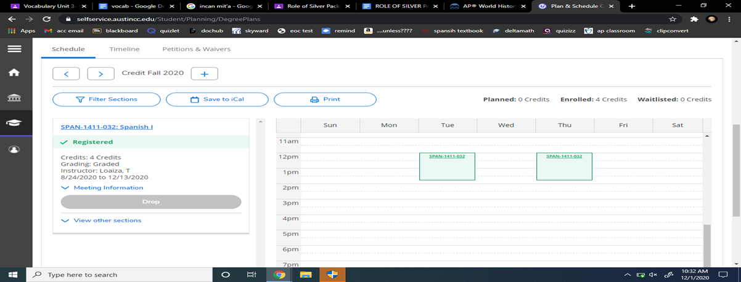
ACC Classes
Step 7: Click on “Meeting Information” and take a picture of the
time and location.
hi

Slide 10
Are you in the correct classes?
If not, please contact Mr. Gordon or Mrs. Jimenez ASAP.
hi

